Slide 1
Lecture 3: Example DFA

Slide 2
Previous Question-HW
[5/7/2020 12:20 PM] Vaibhav Chunekar
L = { w element of (Ꜫ) {0,1}*| w has an ends with a 011}
​
L = { w Ꜫ {a, b, c}*| w has an substring ends with ab}

Slide 3
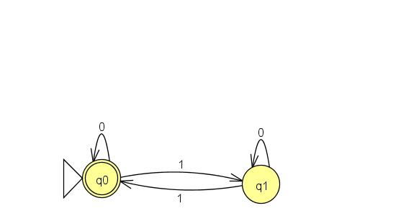
Example 1
L 1= { w {0,1}*| w has an even number of 1’s.}

Slide 4
Lecture 3: Deterministic Finite Automaton
Agenda
Example of DFA
Solution for previous question
Key Concepts
Presented by
Prof. Vaibhav Narayan Chunekar
K. J. Somaiya College off Engineering, Vidyavihar, Mumbai

Slide 5
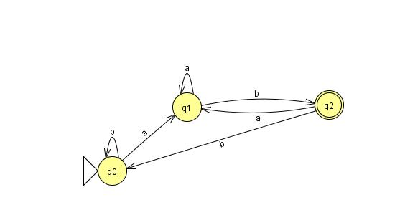
Example2: L2 = { w {0,1}*| w ends with the substring ab}

Slide 6
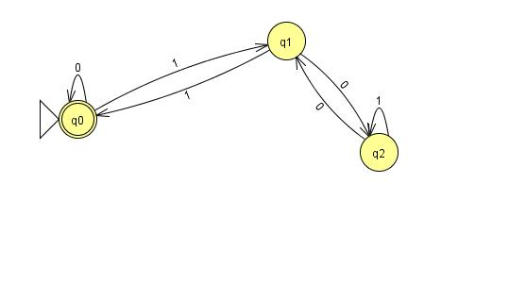
Example 3: L2 = { w {0,1}*| w is divisible by 3}

Slide 7
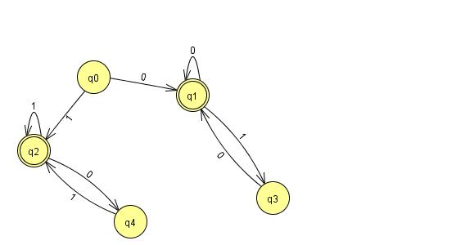
Example 4: L2 = { w {0,1}*| w begins and ends with same symbol}

Slide 8
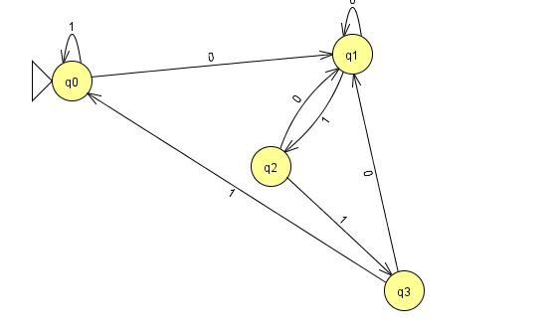
Homework: L = { w element of (Ꜫ) {0,1}*| w has an ends with a 011}

Slide 9
Key Concepts:
Language and DFA
Deterministic Finite Automata (q,a)→q
Finite Nature of Automaton

Slide 10
Thanks !!!!
Any Query

